Slide 1

A DDI Lifecycle Data Warehouse Model

Slide 2
DDI Lifecycle: A Data Warehouse Model
A data warehouse based on the DDI Lifecycle model collects observations and measurements – facts – using instruments and procedures following a protocol in a context
The protocol specifies a longitudinal population study (LPS)
The context includes:
visits or times
an individual and their characteristics
a household and its characteristics and
a (geo)location and its characteristics like climate, toxicants and social determinants of health including location-specific SDG indicators
The context qualifies and adds value to the facts
The context may be used together with the facts downstream in descriptive, predictive and/or causal analyses

Slide 3
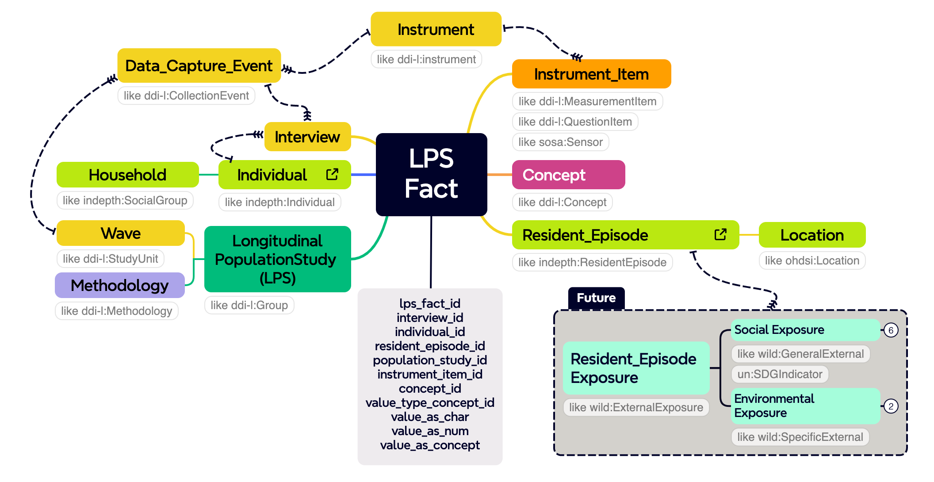
DDI Lifecycle: A Data Warehouse Model

Slide 4
DDI Lifecycle: A Data Warehouse Model
The “things” here next to the facts are their dimensions
The ”ddi-l” ones in the data warehouse model have some of the same properties and relationships they enjoy in the DDI Lifecycle model
“Substantive” properties and relationships remain the same across the two models
Structural properties relating to the construction of the DDI Lifecycle model are not persisted in the DDI-L data warehouse
Instead the DDI-L data warehouse has its own structural properties – foreign key constraints as a rule – between the facts and their dimensions and among the dimensions themselves

Slide 5
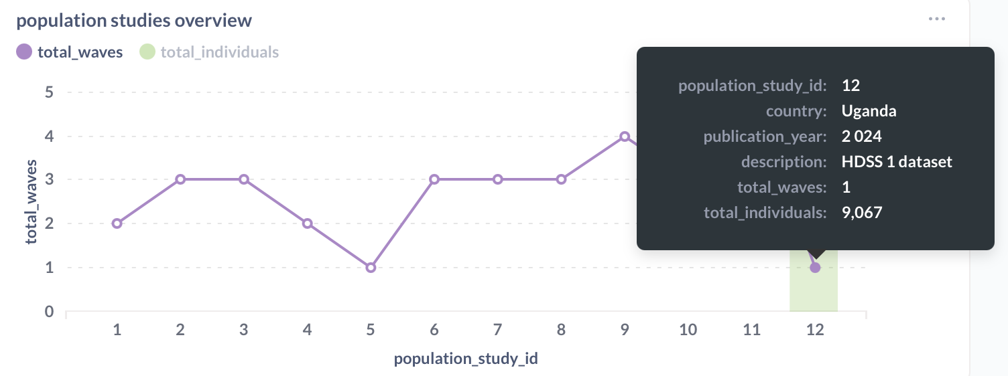
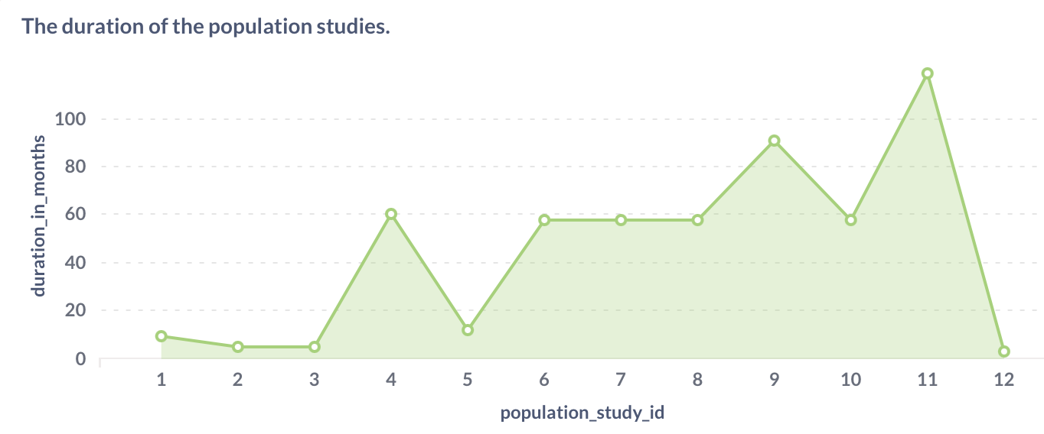
Here is the DDI Lifecycle Data Warehouse dashboard and the several studies it is currently hosting…

Slide 6
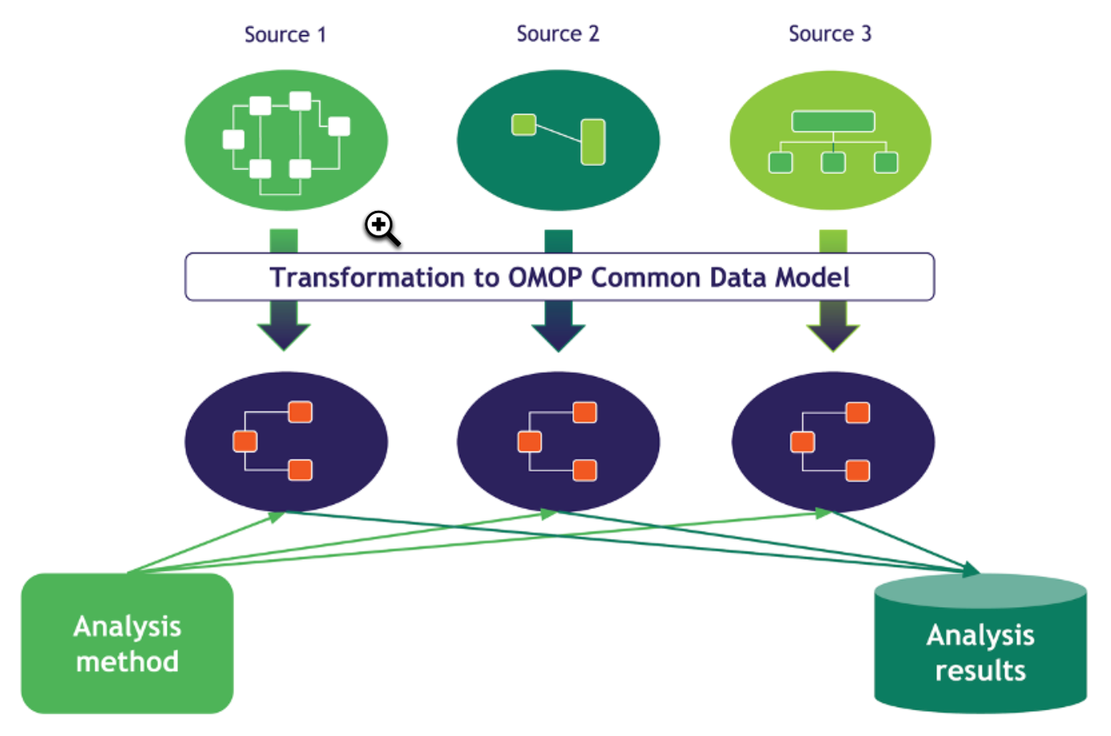
Downstream
A mapping was specified between the DDI Lifecycle Data Warehouse and the Observational Medical Outcomes Partnership Common Data Model (OMOP CDM)
Using this mapping, an ETL was developed
The same ETL has been used to move as many as 12 longitudinal population studies so far into an AWS data enclave for OHDSI analytics from the DDI-L data warehouse

Slide 7
Downstream (continued)
Some studies have the same populations but mostly they did not
Several studies have the same protocol
None of the studies were merged for lack of data sharing agreements
Consequently, each study is hosted in its own OMOP CDM instance in the AWS data enclave
Permissions are restricted by OMOP CDM instance

Slide 8
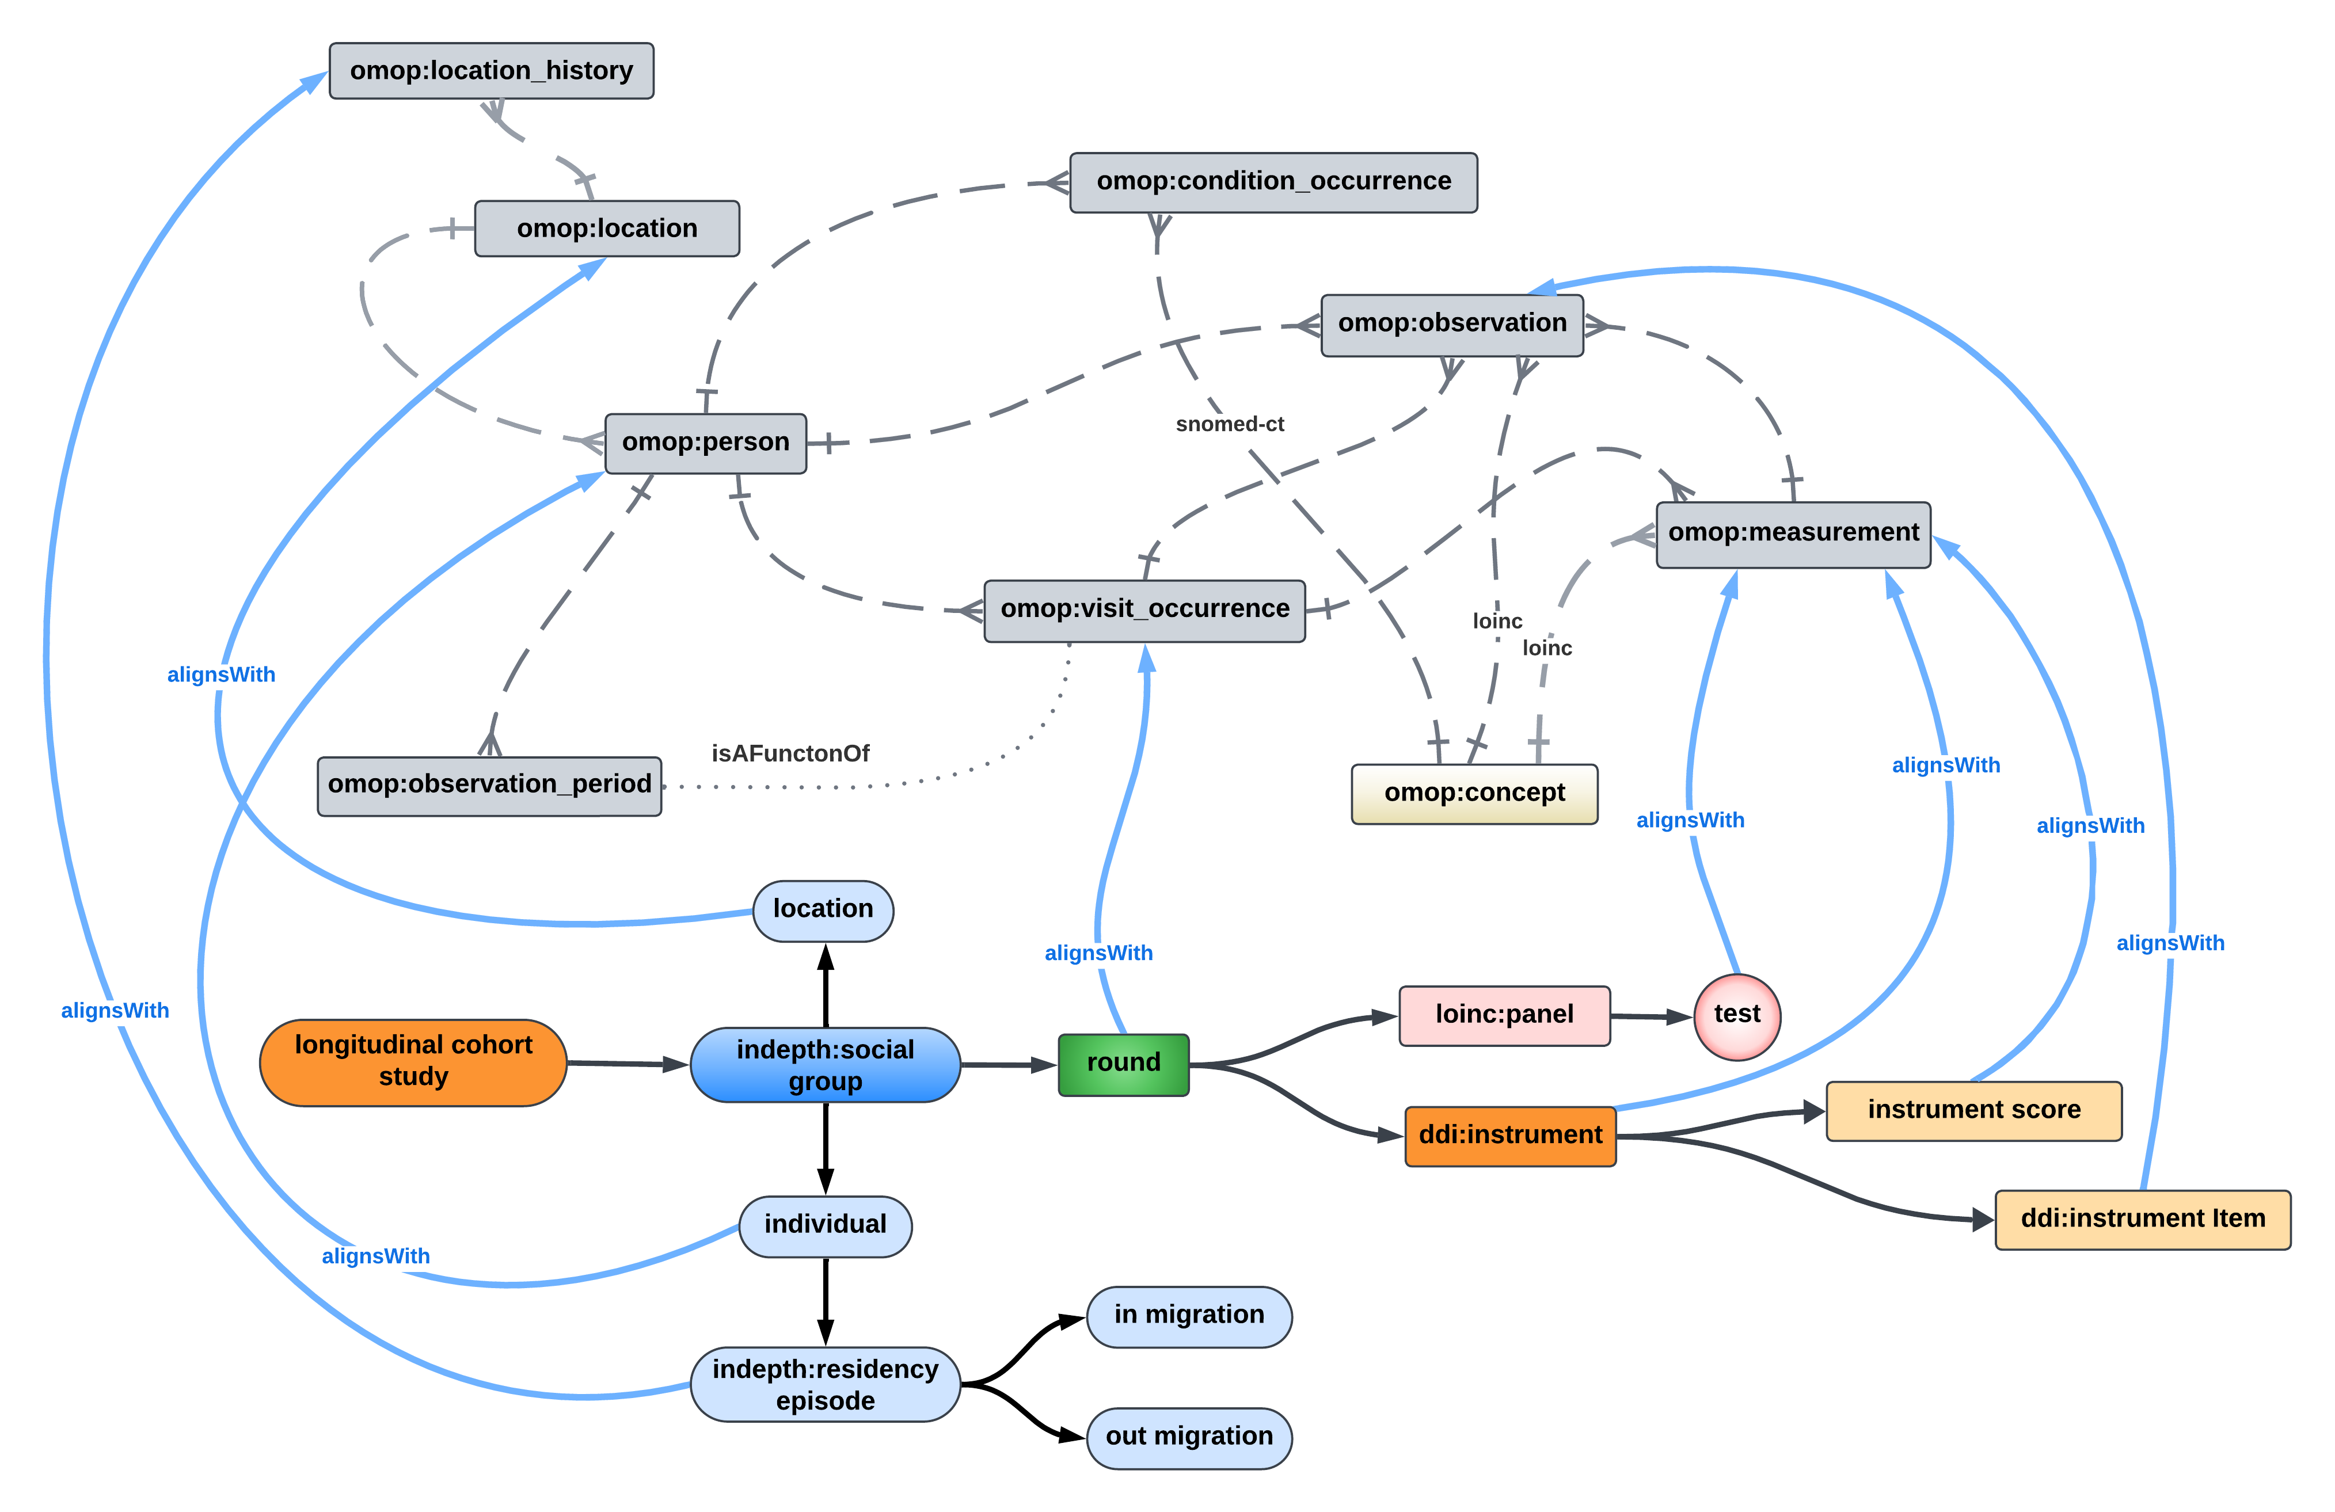
Using a representation of the data warehouse at the bottom, the mapping looks like this…

Slide 9
Two OMOP CDM measurements were created – one for the instrument score and the other for the instrument itself

Slide 10
Instrument items and their answers (aka the data warehouse facts) were mapped to observations

Slide 11
In OMOP CDM 5.4 observations include a foreign key spec. We pointed it to the measurement for the instrument

Slide 12
Some protocols included lab tests. They were mapped to their own measurements in the OMOP CDM

Slide 13
Acknowledgements
The data model for the DDI Lifecycle Data Warehouse was designed and developed by a team of data scientists from three entities – the African Population and Health Research Center (APHRC), the London School of Hygiene and Tropical Medicine (LSHTM) and CODATA
The same group of data scientists was responsible for the mapping between the data warehouse and the OMOP CDM as well as the development of the ETL itself
Wellcome Trust provided the funding

